Slide 1
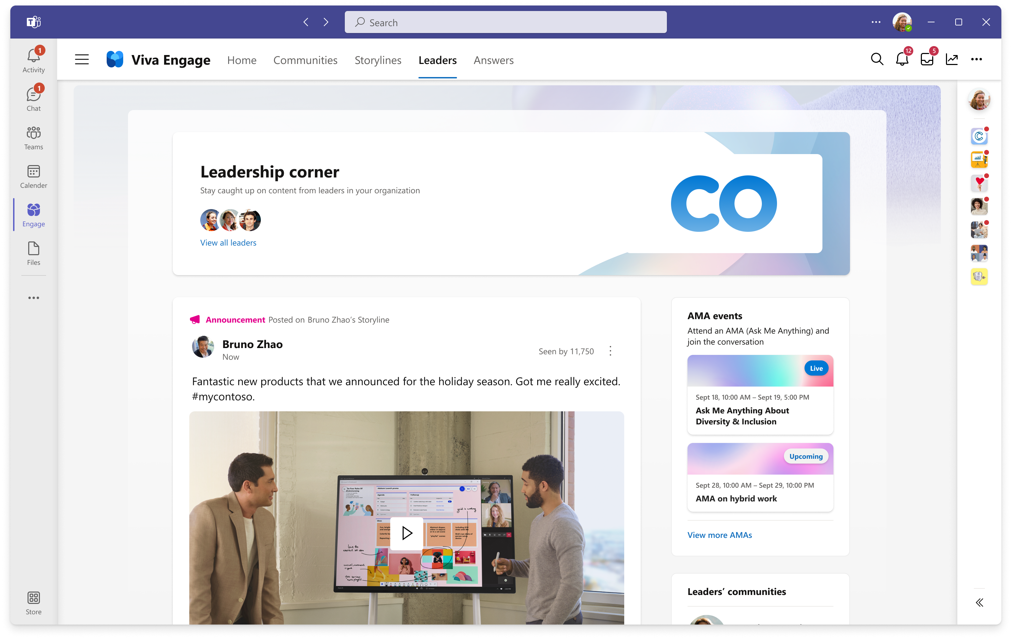
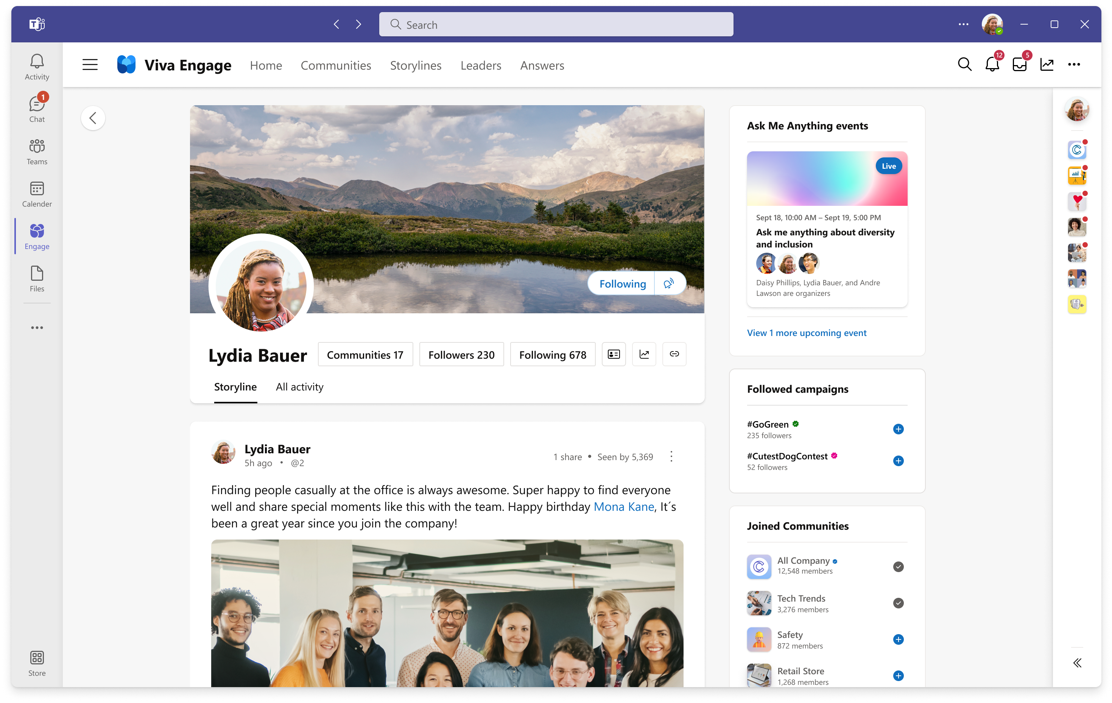
Microsoft Viva Engage
Build meaningful relationships and communities
Connect with leaders and coworkers, find answers to questions, share your story, and find belonging at work.
Leadership Corner
​ A destination for employees to discover and engage with leaders.
Invite questions and build two-way dialogue between employees.
Get a personalized view of curated conversations, events, social campaigns, and community contributions from leaders within an organization in a single place.
Advanced storyline and content capabilities
Define and assign audiences based on teams, departments, or custom criteria​.
Set up delegates to post on behalf of leaders.
Share announcements and showcase what leaders have to say.
Start using Microsoft Viva Engage

Slide 2
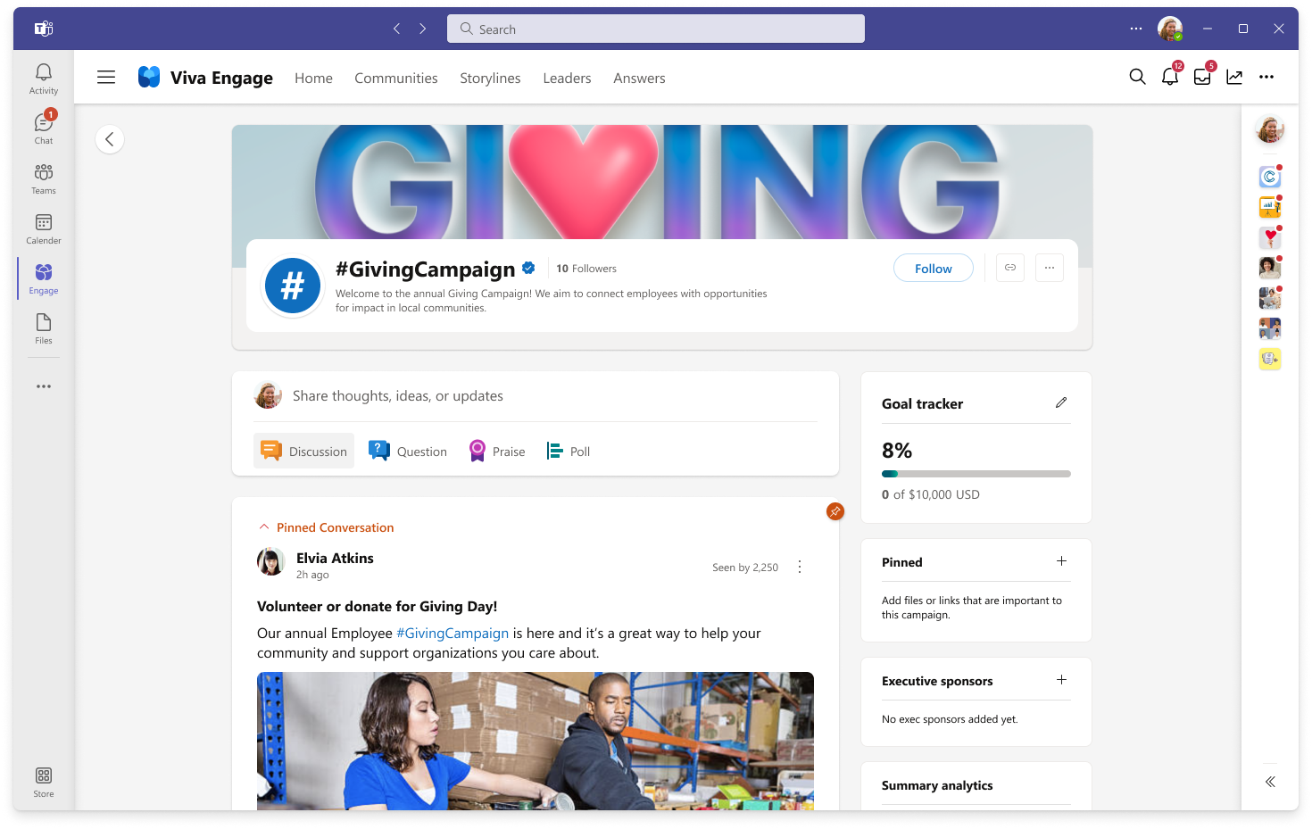
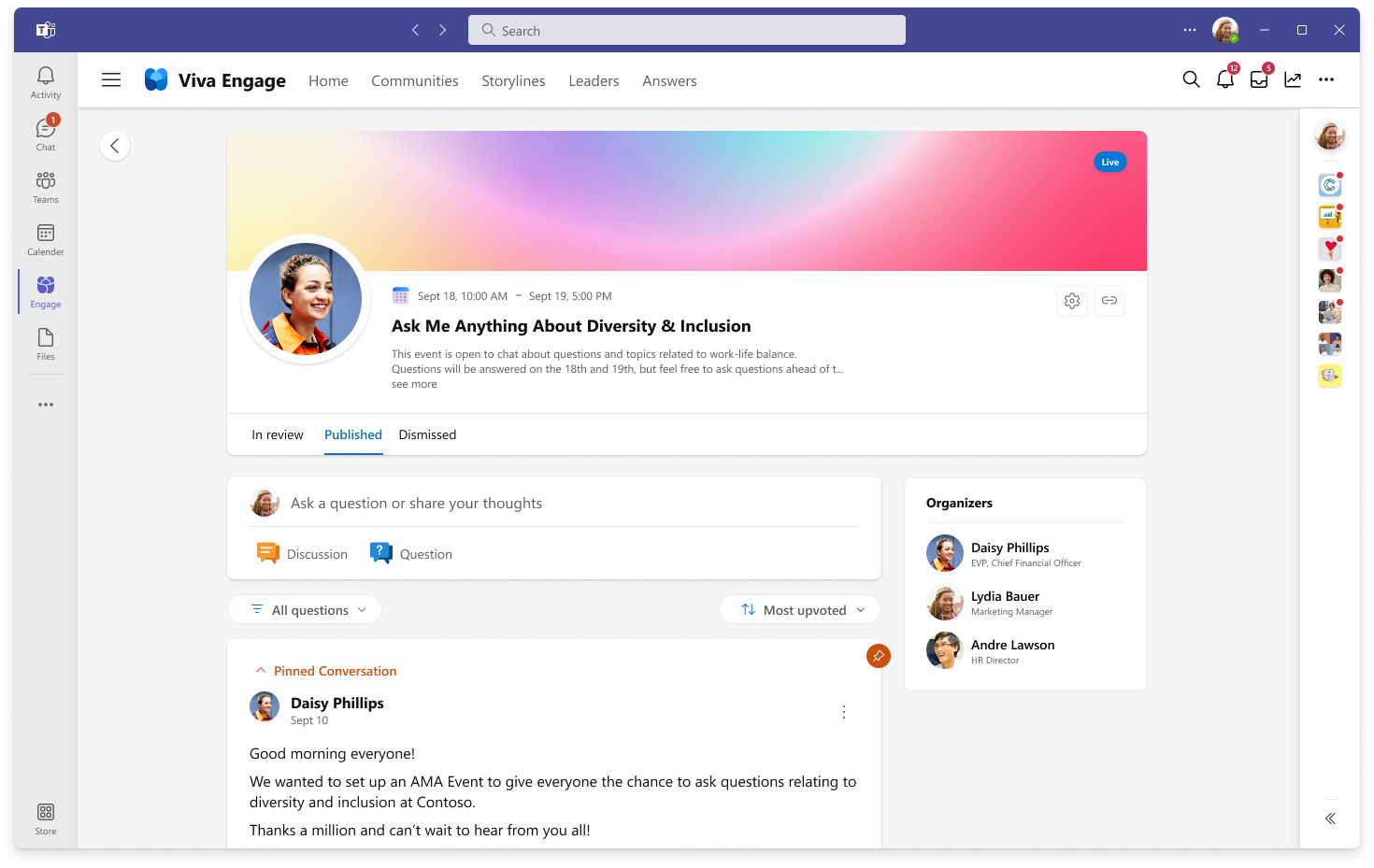
Viva Engage
Build meaningful relationships and communities
Campaigns
Create campaigns to drive important initiatives that support business goals and objectives. ​
Hashtags allow people to find, follow, and participate in the campaign. ​
The goal tracker allows for visible measure of progress towards the campaign's goals. ​
Gain insight about the campaign’s impact and reach with analytics from the last week, month or of all time​.
Ask Me Anything Events
AMAs events are moderated question and answer periods where leaders and employees can connect to ask & address questions​
AMAs are centered around a subject or a panel of expert or leaders in a specific department or area. ​
Organizers can moderate questions as they come in the queue. ​
Keep everyone connected, included, and informed.

Slide 3
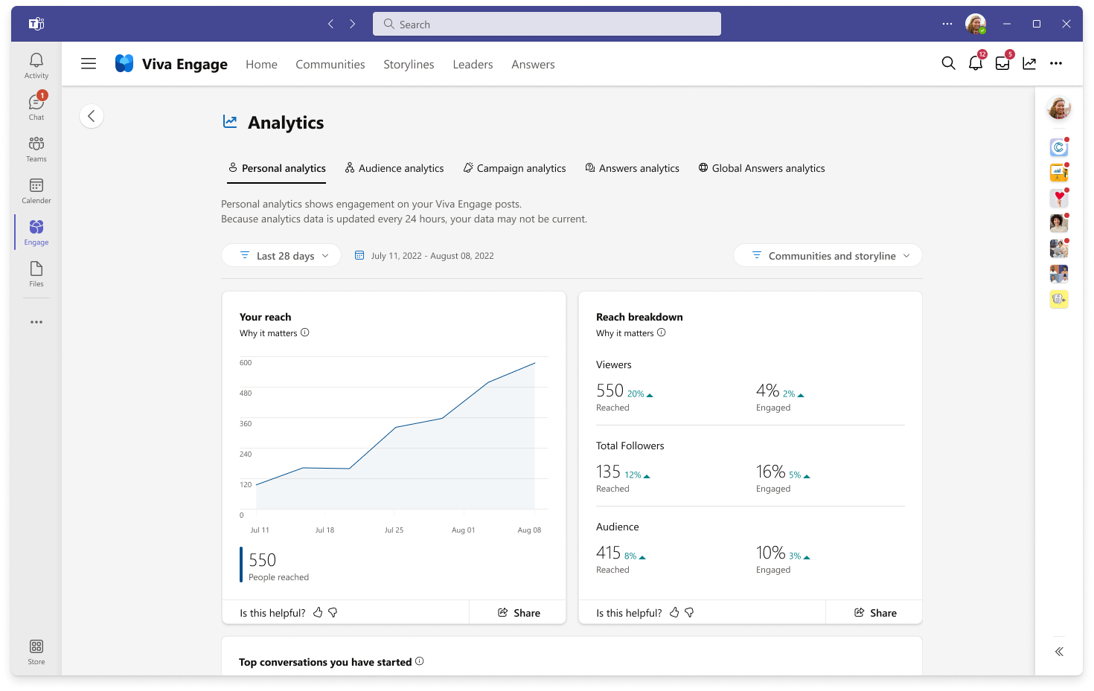
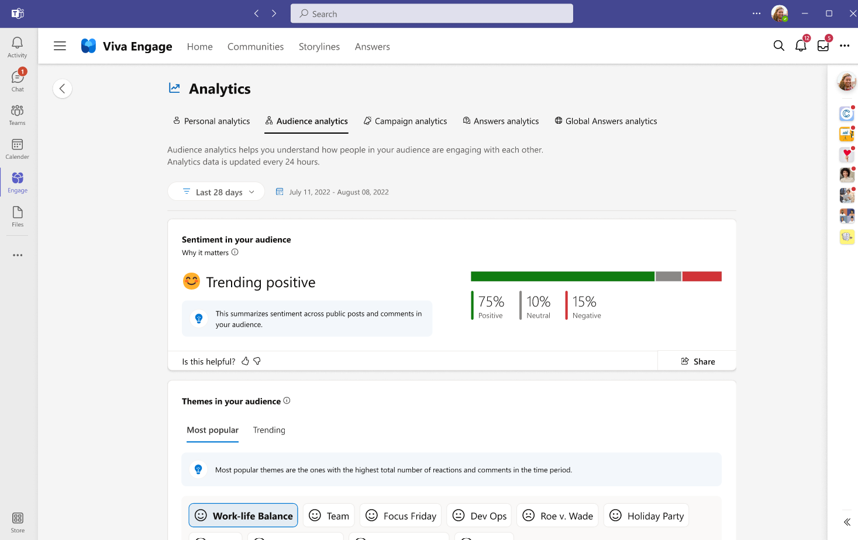
Viva Engage Analytics
Understand communications and engagement metrics
Advanced Analytics
The personal analytics view shows employees how their content is performing in Engage.
Using date ranges and other filters, employees can get helpful dashboards and customizable views
Audience sentiment analysis
This dashboard gives leaders and their delegates detailed analytics to understand their organization’s engagement and sentiment.
A leader with a defined audience, will be able to see how their team or department is engaging and identify trends, helping stay on top of what’s happening and respond to top conversations and active communities to drive the most impact.
Understand impact of contributions. Determine reach of conversations.

