Slide 1
Ready-to-use event signage
Good signage can help your attendees know what to do!
You can save these slides as PNGs and then post them in your events as images to help people new to Mesh understand some of the basics.
Get started here. You might want to add additional signs like directional arrows to specific places in the environment, the event code of conduct, or where to fill out a survey for the event.
(You can also use the Text object to make quick signage.)

Slide 2
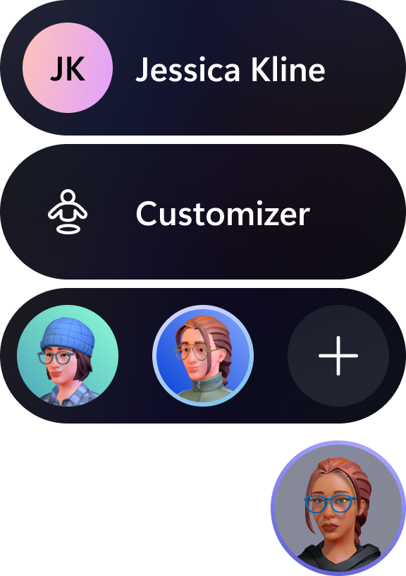
Customize your avatar
Tap on your profile icon for avatar options.
Customize your existing avatar.
Choose or add another avatar.
Profile icon

Slide 3
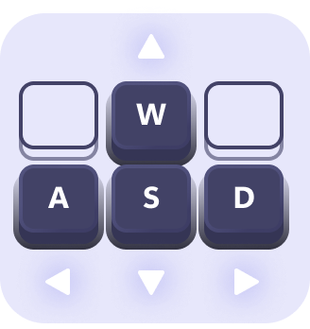
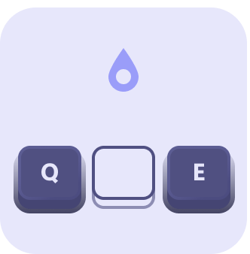
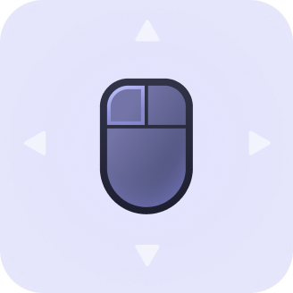
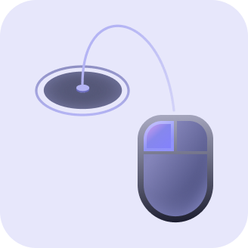
How to move
Get started with these basic controls
Keyboard
Mouse or Trackpad
Press W, A, S, D or arrow keys to walk around
Press Q, E keys to rotate and look right and left
Left click and drag to look around
Left click and hold to teleport

Slide 4
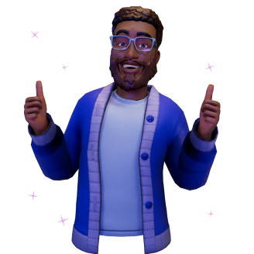
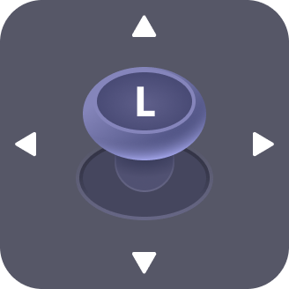
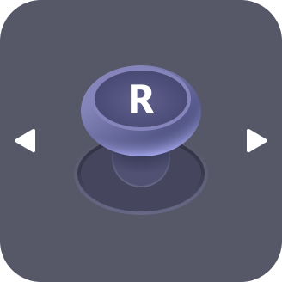
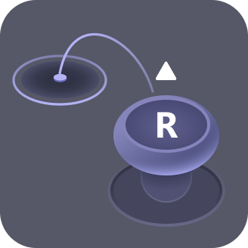
VR Controllers
Use left thumbstick to walk around
Use right thumbstick to look right and left
Push right thumbstick forward to teleport
You can find more how-to in Settings

Slide 5
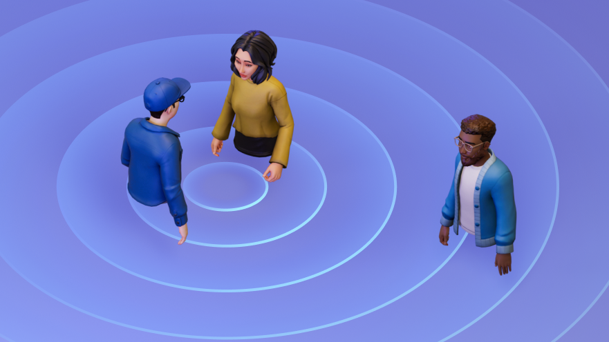
Can’t hear your friend across the room?
Mesh uses Spatial Audio, so you only hear people when they are close to you, and they sound quieter when they move away. Just like real life!

Slide 6
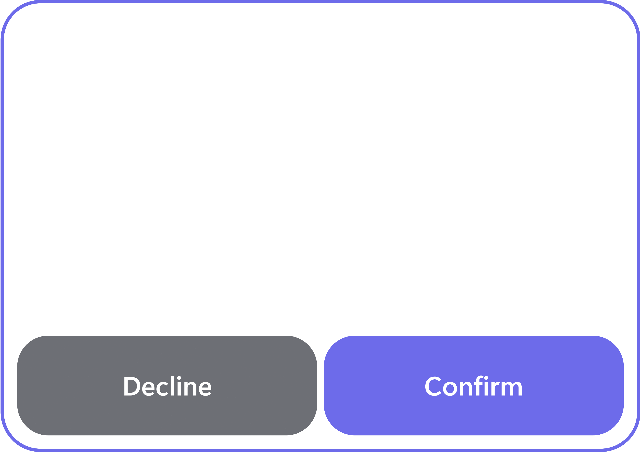
Participating in Q&A
How to ask for a turn to speak
Raise Hand
Accept Request
If Q&A is enabled, you can raise your hand.
The host will call on you when it’s your turn.
Accept the request to go on the air so people in other rooms, including the hosts, can hear you!

Slide 7
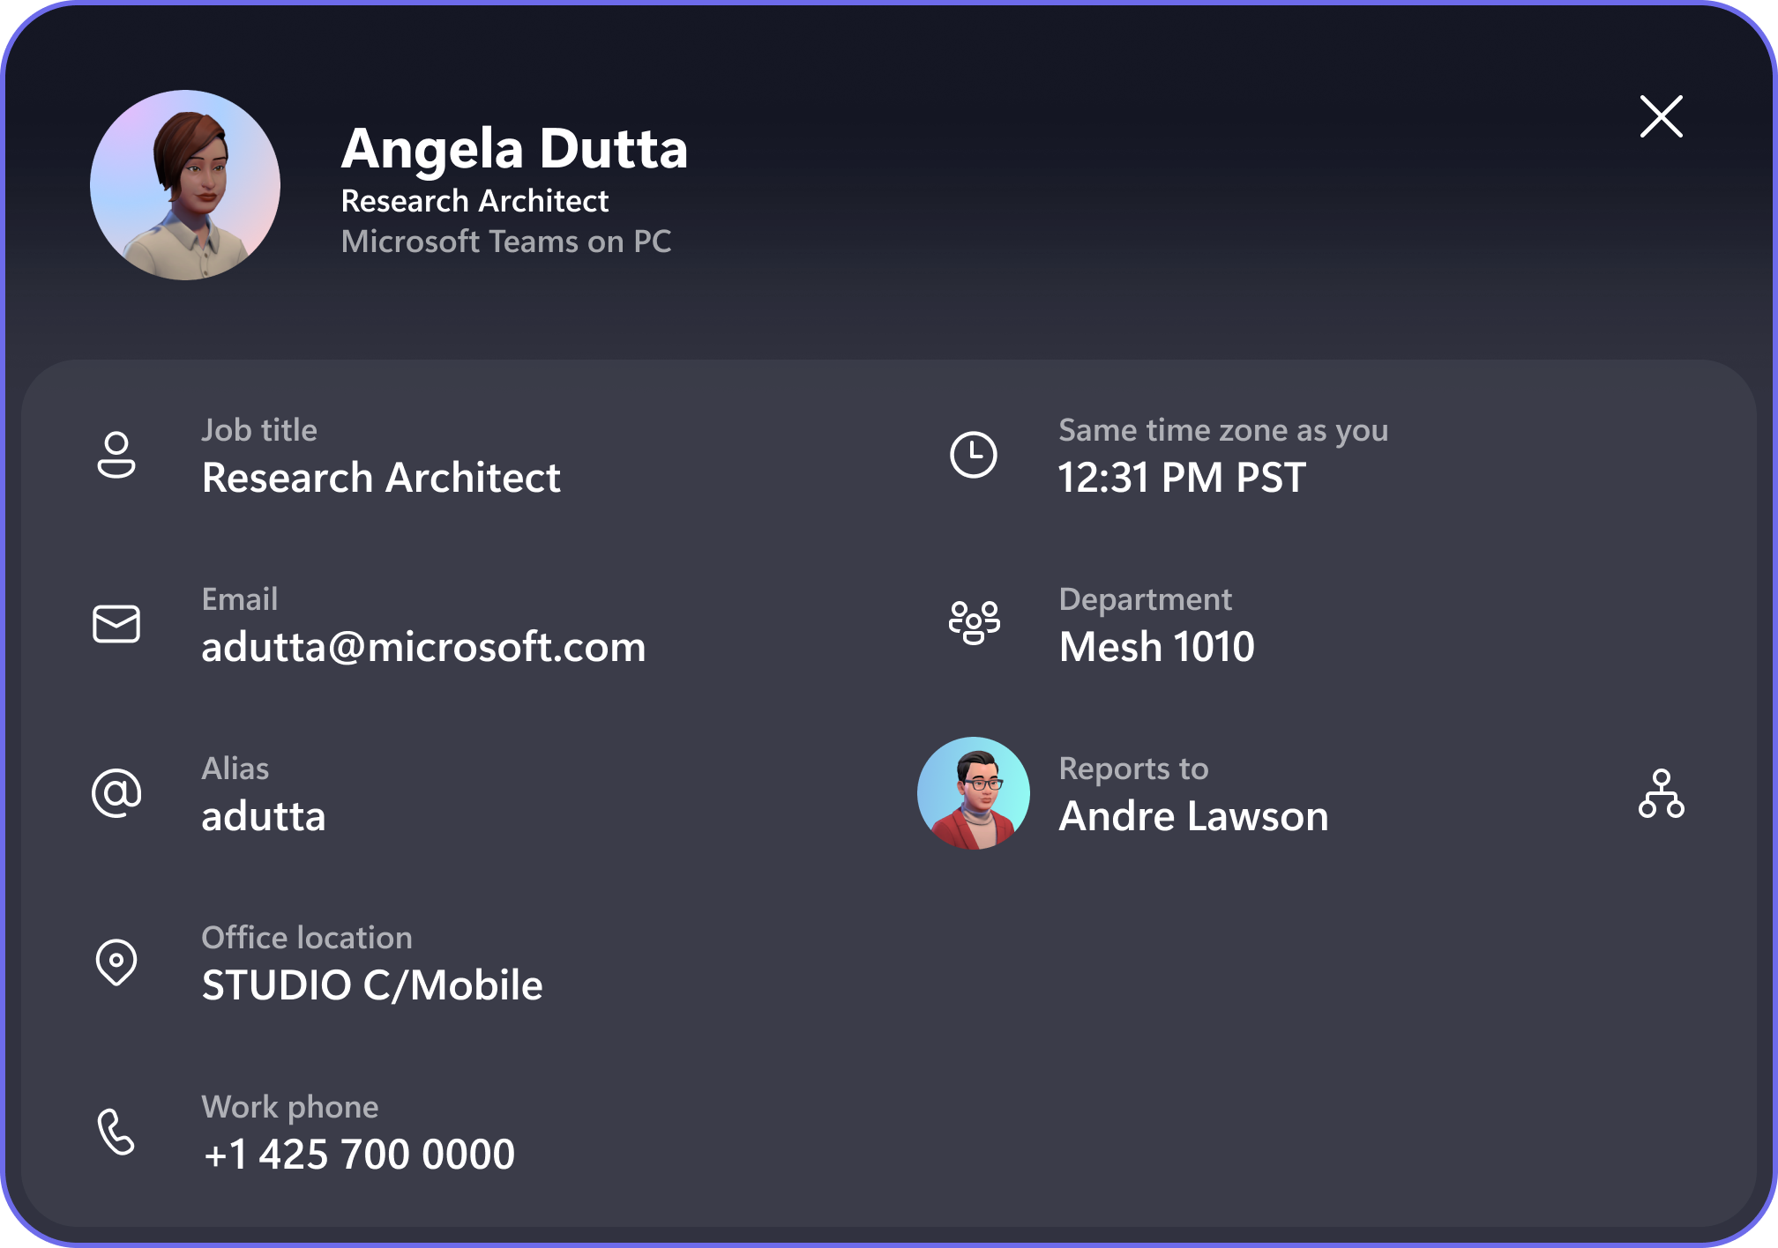
Contact Cards
Find out more about other people in the space
Click someone’s nametag then click the Contact Card icon to see more about them.

Slide 8
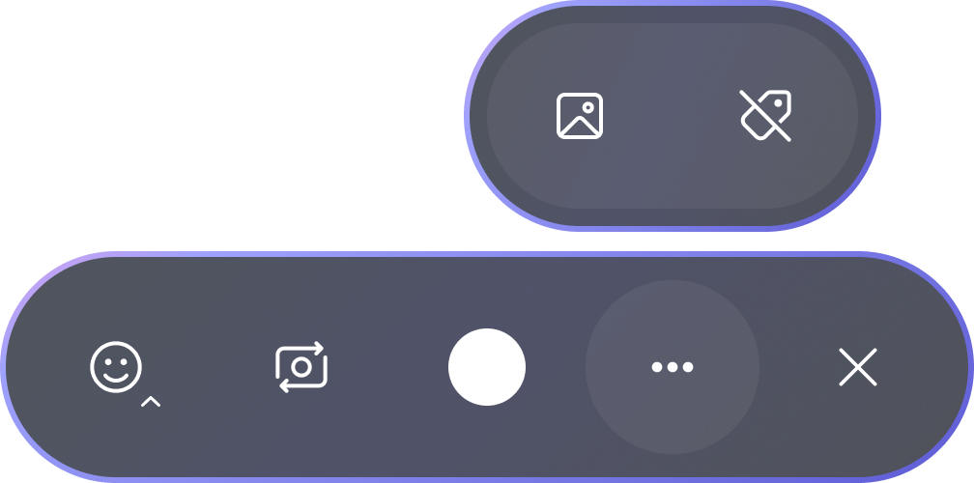
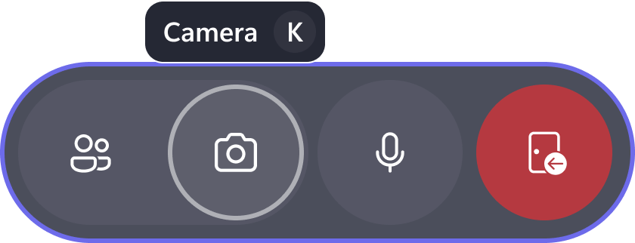
Take a Selfie
Take a selfie of yourself with friends or snap a picture from the view of your avatar!
Find your photo files with the Photo icon
Turn on or off names with the Tag icon
Open the camera with the Camera button in the menu bar
Change views with the Flip Camera button

