Slide 1
Microsoft 365 Copilot training content map
Nov 2024

Slide 2





Training and documentation by phase
Microsoft 365 Copilot
Get ready
Onboard & engage
Deliver impact
Extend & optimize
Copilot Experiences Explained
(11 mins)
Leading in the Era of AI:
Creating an AI Council
Discover how to drive enablement of Microsoft 365 Copilot in your organization (2.5 hrs)
User Experience Strategy template
Copilot Prompt Gallery
(including app specific guidance)
Leading in the Era of AI:
It’s about Trust
Learn about Copilot prompts
Empower your workforce with Microsoft 365 Copilot Use Cases
(7 business group use cases)
Craft effective prompts for Microsoft 365 Copilot (2 hrs)
Get better results with
Copilot Prompts
Edit a Copilot prompt to
make it your own
Share your best prompts
Modern Collaboration Architecture people-centric scenario guidance
Video
Docs
Course
Docs
User Enablement
Article
Tool
Course
Course
Article
Article
Article
Article
Article
Prepare your organization for Microsoft 365 Copilot (1.5 hrs)
How Microsoft 365 Copilot works (11 mins)
How to get ready for Microsoft
365 Copilot (9 mins)
Data, Privacy, and security for Microsoft 365 Copilot
Microsoft 365 Copilot requirements
Get started with Microsoft 365 Copilot (2 hrs)
Admin steps to get ready for Microsoft 365 Copilot (46 secs)
Apply principles of Zero Trust to Microsoft 365 Copilot
Enable users for Microsoft 365 Copilot
Microsoft 365 Copilot Documentation
Copilot Dashboard implementation
Extend Microsoft 365 Copilot
Create copilots with Microsoft Copilot Studio (4 hrs)
Optimize and extend Microsoft 365 Copilot (1 hr)
Extend and manage Microsoft Copilot Studio copilots (2 hrs)
Build connectors and plugins for Microsoft 365 Copilot (3 hrs)
Course
Course
Docs
Docs
Video
Video
Docs
Technical Readiness
Course
Video
Docs
Course
Docs
Docs
Course
Docs
Course

Slide 3
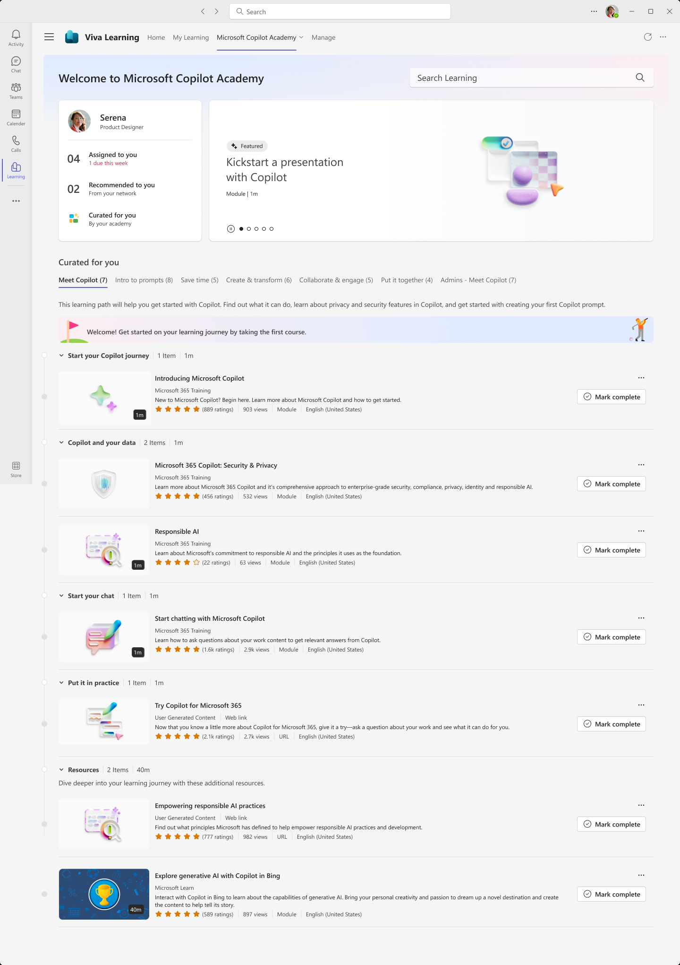
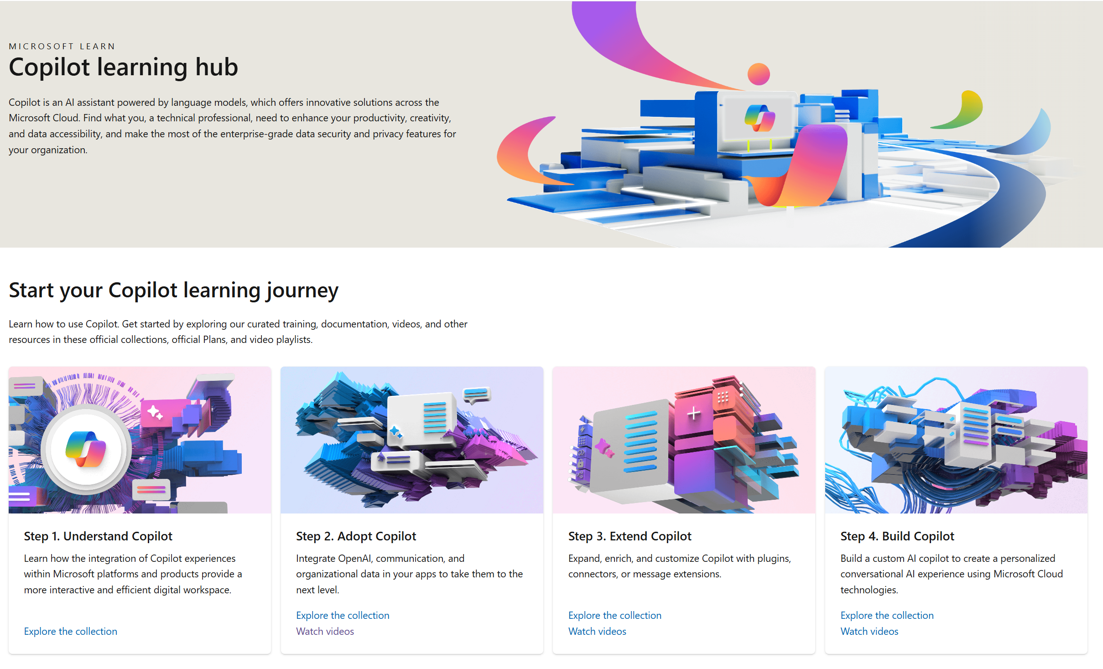
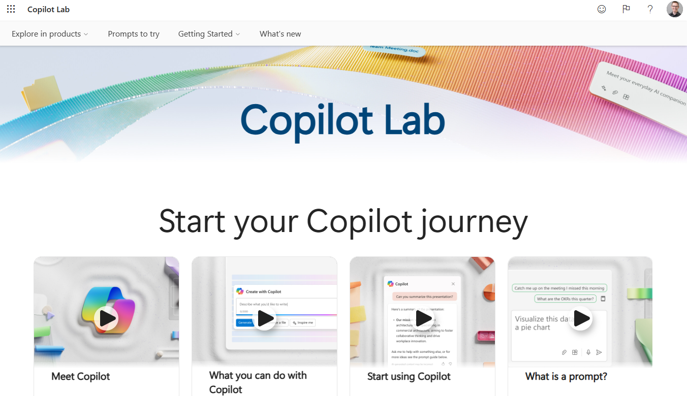
Skilling experiences
Microsoft 365 Copilot
Microsoft Learn
Free, on-demand training content
for skill development
Step-by-step exercises guiding learners through common Copilot prompts and use cases
Microsoft
Copilot Academy
Centralized location to help with the basics of Copilot learning and upskilling, pulling the best content from available free Microsoft sources
Structured content in easily consumable learning paths curated
by Microsoft experts
Develop your AI interaction skills from your Viva Learning app
in Teams or webapp
Copilot Prompt Gallery
Free location to meet, learn about,
and test the capabilities of Copilot
Improve your prompt engineering skills in an interactive hands-on environment
Downloadable assets for customization available at adoption.microsoft.com/copilot

